Slide 1
Welcome
To the Staff Wellbeing Hub online launch event
The Staff
Wellbeing Hub

Slide 2
Opening address
Jay Nairn
NHSE&I Senior Programme Manager
The Staff
Wellbeing Hub

Slide 3
What do staff need now?
Relationships are the basis of recovery: staff want and deserve real contact with experienced mental health experts at the outset.
Whole-system thinking: to work productively across agencies to create easy and timely access for staff and plug any gaps.
Normalisation and strengths-based approach: non-pathologising language and preventative offers for individuals and teams.
Empowerment: a range of quality offers to choose from, including specialist therapy and confidential self-referral.
Addressing complexity: dealing with the unique and multi-layered nature of staff mental health.
The Staff
Wellbeing Hub

Slide 4
What are we targeting?
Wellbeing promotion
Somatic symptoms of stress
Burnout
PTSD
Anxiety/
depression
Moral injury
Operational/
leadership support
Self-monitoring
Bereavement
The Staff
Wellbeing Hub

Slide 5
Our offer and task
Therapies/
interventions
Coaching
Collating offers/assets
Wellbeing monitoring
Specialist mental health assessment
Signposting
Pathways with partners
Balint
groups
Phone line
Proactive
outreach
Prevention
Local HEE
webinar series
The Staff
Wellbeing Hub

Slide 7
Helpline
Our confidential helpline is staffed by expert NHS psychological practitioners, who understand what you’re going through.
It is open to all health and care staff.
If you need to talk, call us on 0191 223 2030.
The helpline is available seven days a week including Bank Holidays, from 7am-9pm.
The Staff
Wellbeing Hub

Slide 8
Quotes from staff who called the helpline:
“The time was invaluable to me personally.”
“I have never reached out to anyone before; I felt very much at ease and felt that it was ok to just be ‘myself’ during the session.”
“I felt I had time and was there was no judgement, just validation.”
“I had ‘time out to talk,’ it helped me to voice my feelings, helping to go on and seek help in my own right. I was in a spiral that I just couldn’t get out of; by talking them through it helped me to see a way forward.”
“I feel that I have found a strength, I feel more relaxed and better about me.”
The Staff
Wellbeing Hub

Slide 9
Themes from staff calling the helpline:
Guilt at not working
Lack of recognition of situation of staff from the organisation
“Triple whammy”
To not pathologise
A safe space to stop & think
It is distinctly different from usual therapeutic encounters
Not debriefing
Moral injury
It is “very useful”
The Staff
Wellbeing Hub

Slide 10
Link Staff:
Staff Wellbeing Hub
Debbie Strachan
Claire Chapman
Claire Chapman/ Paras Patel
Sara Hudson
Lyn Williams
Samantha Swift
Kristina Gray
Care homes
Primary Care

Slide 11
Outreach
We offer (where possible) a named link person between the Staff Wellbeing Hub in each of these settings.
I.e. Acute in-reach to health psychology/occupational therapy staff to:
Build effective relationships and improve communication between organisations and the Staff Wellbeing Hub
Support the organisations to help navigate the North East & North Cumbria system offer
Promote the Staff Wellbeing Hub offers and plug any gaps in provision
Ward in-reach (where possible)
The Staff
Wellbeing Hub

Slide 12
Moral injury…
Is when you are troubled by your own actions or other people’s actions, that you feel are wrong or against good practice;
Is not a mental illness in itself but good support can make the difference between developing mental illness and positive wellbeing;
Is emerging as an important area in the pandemic, so we did a survey of local essential workers…
The Staff
Wellbeing Hub

Slide 13
The survey received 566 responses across Health and Care, Local Government & Education, and other essential worker sectors.
Generally, people appeared less troubled by their own actions compared with other people’s actions that they felt were wrong:

Slide 14
Survey findings and what we are doing
Staff asked for:
Supervisor check-ins
Kindness from everyone
Fair rules & enforcement
Effective communication & processes
We are:
Sharing findings & suggestions with local organisations
Writing an academic paper
Producing a video about things everyone can do
Working with the hub to develop offers that can help with moral injury and staff wellbeing
The Staff
Wellbeing Hub

Slide 15
Things everyone could consider:
Check-ins: Who will you contact to let them know what you, or your staff, need from them to function well? How can you connect?
Kindness: What can you do, for one other person today, that might help them feel supported and connected? What would help you to stay regulated enough not to pass your stress on?
Fair rules & enforcement: Who do you need to have a conversation with to better understand each other’s needs and values?
Effective communication/processes: What can you do to share ideas, feedback or decisions clearly at the right time with the right people?
For more info search moral injury on www.recoverycollegeonline.co.uk/
The Staff
Wellbeing Hub

Slide 16
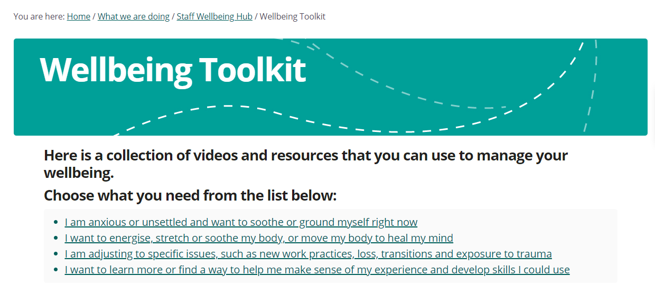
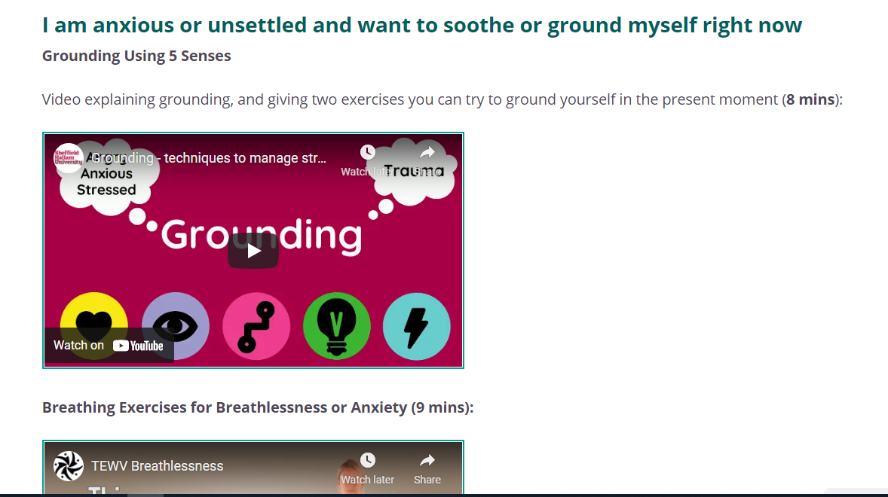

Slide 18
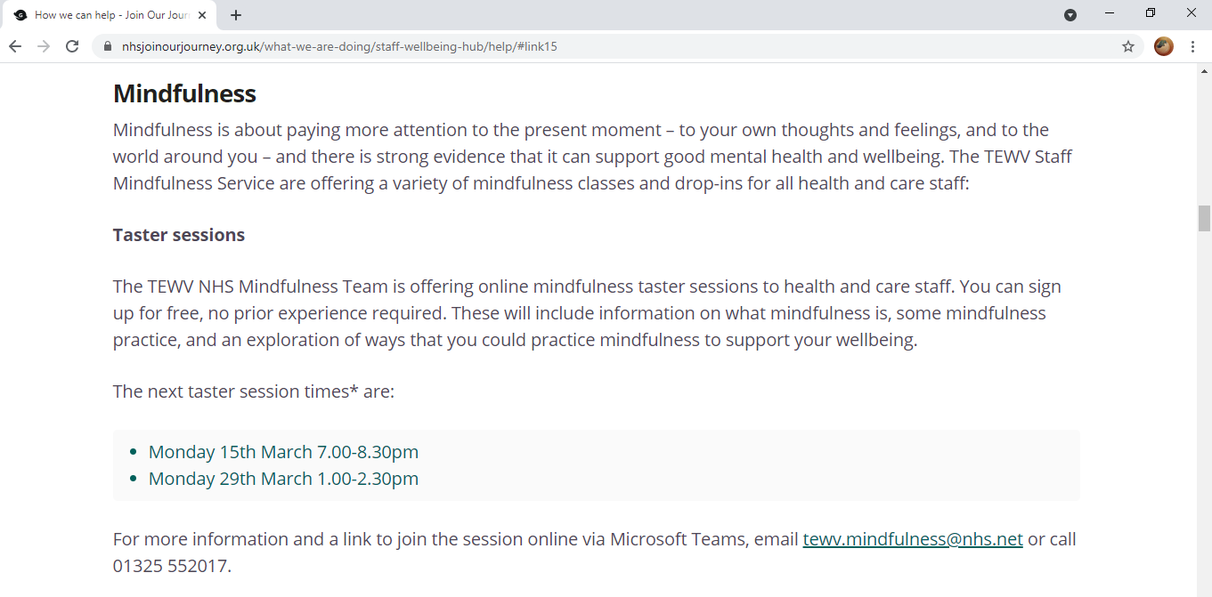

Slide 19
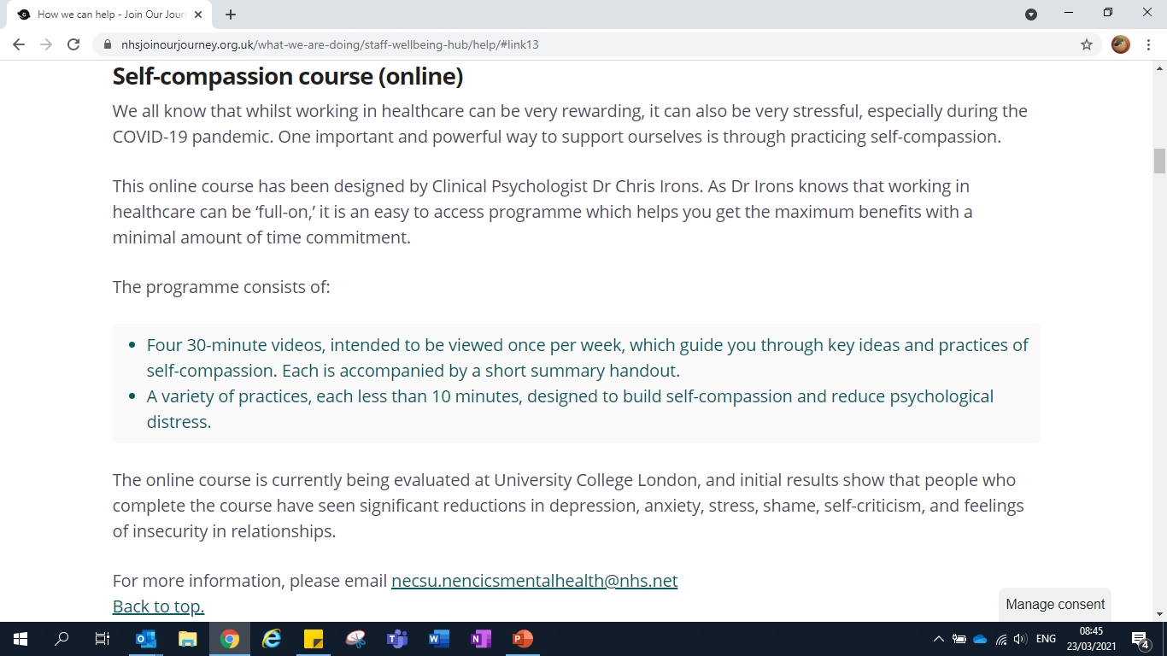

Slide 21
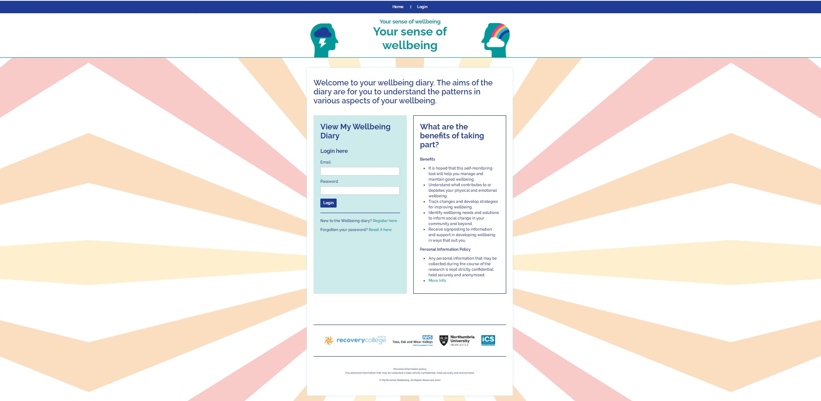
Overview
Holistic view of mental health
Allow self monitoring and reflection
Risk indicators
Allows organisational and public health data

Slide 22
Q&A
The Staff
Wellbeing Hub

Slide 23
Visit nhsjoinourjourney.org.uk
The Staff Wellbeing Hub

