Slide 1
Introducing

Slide 2

Have you heard…
#itscannyupnorth

Slide 3
The Find
Your Place campaign
is a collaboration between NHS trusts across our fabulous region

Slide 4
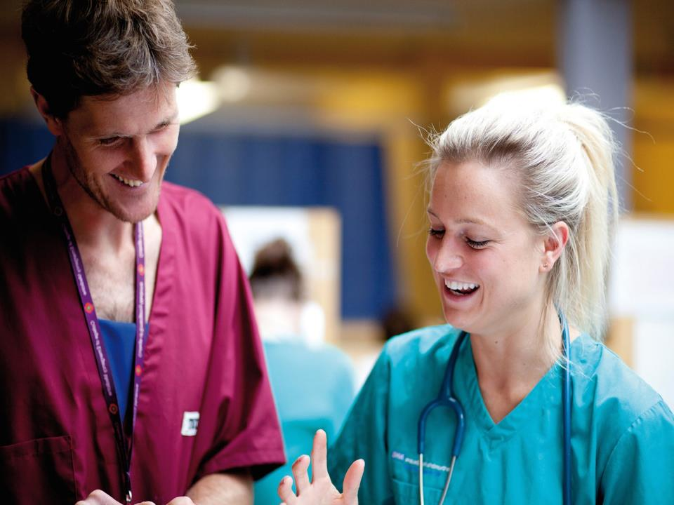
It promotes the high quality of medical training and lifestyle on offer to recruit more medical trainees to our region.

Slide 5
It’s time to shout about what we love most about living and training in the region
So join our movement…

Slide 6
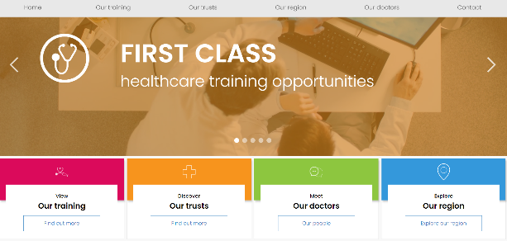
So check out our website and sign up for updates

Slide 7
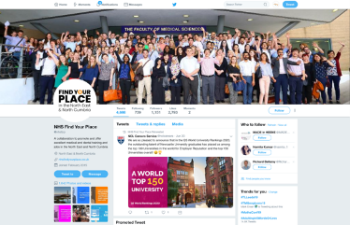
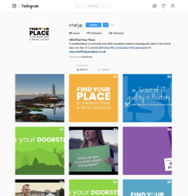
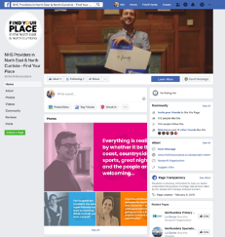
Join us on social media
@nhsfyp

Slide 8
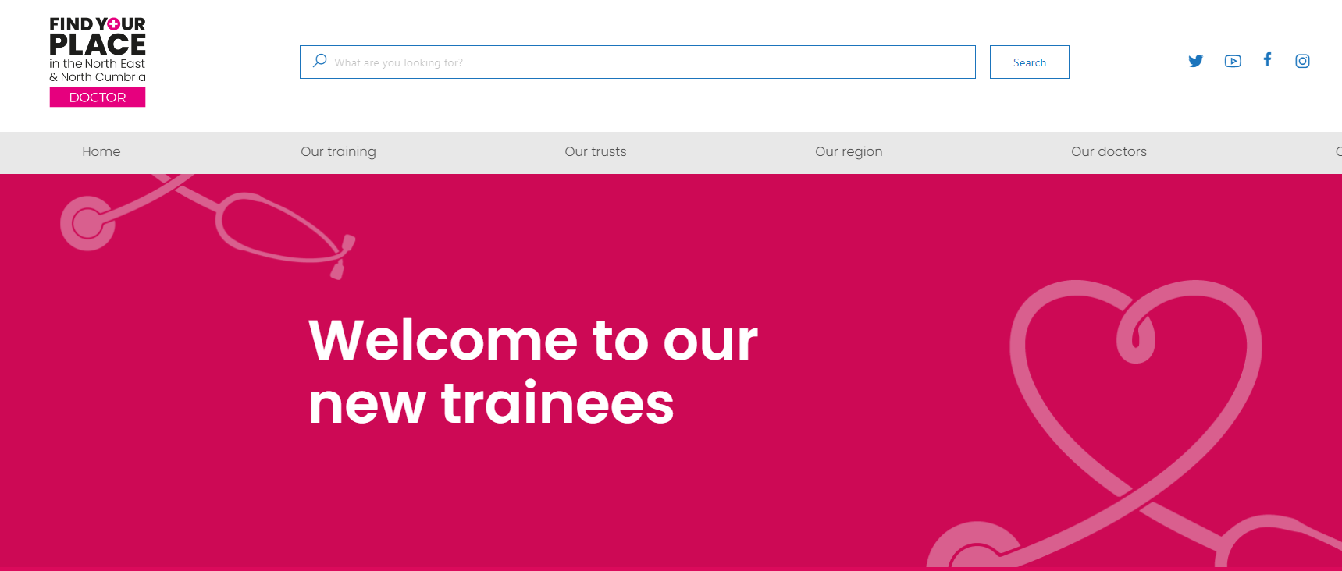
Visit our Found Your Place welcome webpage
Visit www.nhsfindyourplace.co.uk/welcome/

Slide 9

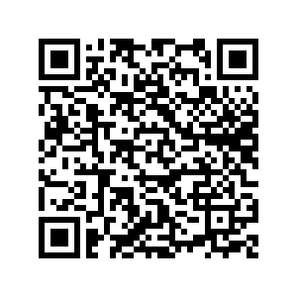
Download the app
Manage your career with the Found Your Place app
Your one stop careers information hub for foundation doctors in the Northern Foundation School and suitable for all trainees in the North East and North Cumbria region.
Our top Found Your Place app features include:
An extensive information hub including career and learning opportunities
A calendar including all key recruitment dates and regional career events
A section on mental health support
Links to HR policies and procedures
Scan QR code for link to download the app

Slide 10
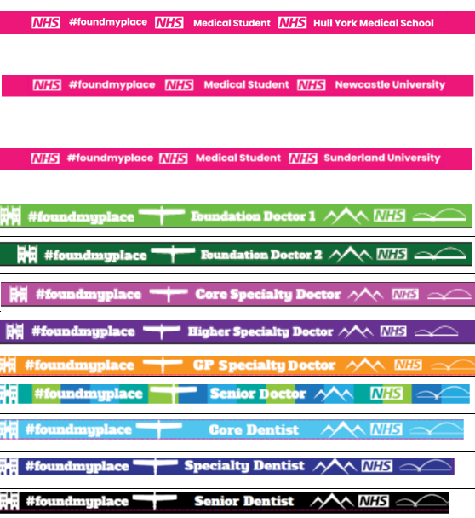
Get your lanyard!
You should receive a #foundmyplace lanyard within one month of starting
If you have not received one, please do get in touch and we will make sure you receive one.
alastair.railton2@nhs.net

Slide 11

And if you would like to share your story get in touch

Slide 12
Thank you!
www.nhsfindyourplace.co.uk

